Slide 1
Operators and Expressions
Dr. Nachiket Tapas

Slide 2
Based on number of operands
Unary operator (single operand)
Binary operator (two operands)
Ternary operator (three operands)

Slide 3
Types of operators
Arithmetic operators
Relational operators
Logical operators
Increment and decrement operators
Assignment operators
Conditional operators
Bitwise operators
Special operators

Slide 4
Arithmetic Operators
+ | Addition or unary plus
- | Subtraction or unary minus
* | Multiplication
/ | Division
% | Modulo division

Slide 5
Unary Operators
Operators that take only one argument
-5
+3
-no1

Slide 6
The / Operator: for integers
When both operand of / are of type integer
Result is integer part of the division
Result is of type integer (floor value of the actual result)
9/2 gives output 4
1/2 gives output 0

Slide 7
The / Operator: for float
When either or both operand of / are of type float
Result is same as real division
Result is of type float
9.0/2 gives output 4.5
1.0/2 gives output 0.5

Slide 8
The % Operator
The remainder operator or % operator returns integer remainder of the division.
Both operands must be integer
4%2 gives output 0
31%3 gives output 1

Slide 9
Division / and Remainder %
Second operand cannot be 0
else run time error
What will be the output of the following?
8/-3
8%-3

Slide 10
Relational Operators
< | is less than
<= | is less than or equal to
> | is greater than
>= | is greater than or equal to
== | is equal to
!= | is not equal to

Slide 11
Relational Operators (contd.)
The result of the expression is always TRUE (1 or non-zero) or FALSE (0).
#include<stdio.h>
void main() {
printf("%d", 8 < 3);
printf("%d", 8 <= 3);
printf("%d", 8 > 3);
printf("%d", 8 >= 3);
printf("%d", 8 == 3);
printf("%d", 8 != 3);
}

Slide 12
Logical Operators
&& | Logical AND
|| | Logical OR
! | Logical NOT
The result of the expression is always TRUE or FALSE.

Slide 13
Truth Table
A | B | A && B
0 | 0 | 0
0 | 1 | 0
1 | 0 | 0
1 | 1 | 1
A | B | A || B
0 | 0 | 0
0 | 1 | 1
1 | 0 | 1
1 | 1 | 1
A | ! A
0 | 1
1 | 0

Slide 14
Usage
#include<stdio.h>
void main() {
printf("%d", 3 < 8 && 3 < 9);
printf("%d", 3 < 8 || 3 > 9);
printf("%d", !8 );
}

Slide 15
Operator Chain
A || B || C || D || …. || Z
Condition check till true is found.
A && B && C && D && …. && Z
Condition check till the end.

Slide 16
Increment and Decrement Operators
Pre-increment | ++A
Post-increment | A++
Pre-decrement | --A
Post-decrement | A--

Slide 17
Program
#include<stdio.h>
void main() {
int a = 2;
printf(“%d”, a++);
printf(“%d”, ++a);
printf(“%d”, a--);
printf(“%d”, --a);
}
What about the following program?
#include<stdio.h>
void main() {
int a = 2;
a++;
printf(“%d”, a);
++a;
printf(“%d”, a);
}

Slide 18
Assignment Operators
A = A + 1 | A += 1
A = A - 1 | A -= 1
A = A * 5 | A *= 5
A = A / 5 | A /= 5
A = A % 5 | A %= 5
The advantage of assignment operators:
Reduced code
Evaluated only once

Slide 19
Usage
#include<stdio.h>
void main() {
int I = 1, sum = 0;
sum += I;
printf("Sum of numbers till %d is %d\n", I, sum);
I += 1;
sum += I;
printf("Sum of numbers till %d is %d\n", I, sum);
I += 1;
sum += I;
printf("Sum of numbers till %d is %d\n", I, sum);
I += 1;
}

Slide 20
Interesting Code
Code1:
A = 5;
A = A++ + 5;
O/P: 10

Slide 21
Conditional Operators
Ternary operator
exp1 ? exp2 : exp3
If exp1 evaluates to true, exp2 is executed. Else exp3 is executed.

Slide 22
Usage
#include<stdio.h>
void main() {
int number, output;
printf("Enter a numbers:\n");
scanf("%d", &number);
output = number % 2 ? 0 : 1;
printf("Is number even: %d", output);
}

Slide 23
Bitwise Operators
& | Bitwise AND
| | Bitwise OR
^ | Bitwise XOR
<< | Shift Left
>> | Shift Right

Slide 24
Example
#include <stdio.h>
int main() {
int a = 5, b = 9;
printf("%d\n", a&b);
printf("%d\n", a|b);
printf("%d\n", a^b);
printf("%d\n", a<<1);
printf("%d\n", a>>1);
return 0;
}

Slide 25
Special Operators
comma operator
value = (x=5, y=7, x+y);
printf(“%d”, value);
sizeof()
printf(“%d”, sizeof(int));

Slide 26
Operator Precedence

Slide 27
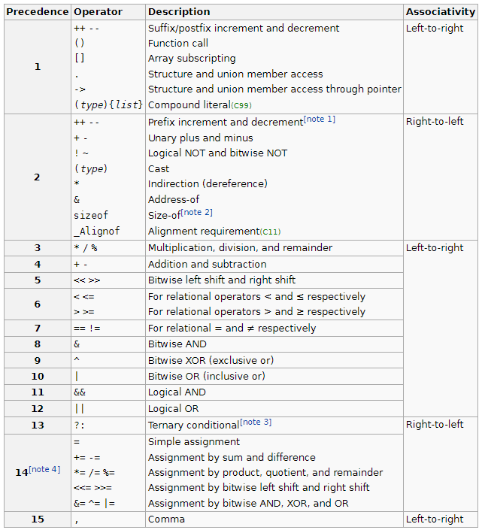
Operator Precedence in C

Slide 28
Code
#include <stdio.h>
main() {
int a = 20;
int b = 10;
int c = 15;
int d = 5;
int e;
e = (a + b) * c / d; // ( 30 * 15 ) / 5
printf("Value of (a + b) * c / d is : %d\n", e );
e = ((a + b) * c) / d; // (30 * 15 ) / 5
printf("Value of ((a + b) * c) / d is : %d\n" , e );
e = (a + b) * (c / d); // (30) * (15/5)
printf("Value of (a + b) * (c / d) is : %d\n", e );
e = a + (b * c) / d; // 20 + (150/5)
printf("Value of a + (b * c) / d is : %d\n" , e );
return 0;
}
Value of (a + b) * c / d is : 90
Value of ((a + b) * c) / d is : 90
Value of (a + b) * (c / d) is : 90
Value of a + (b * c) / d is : 50

Slide 29
Thank You!!

